Slide 1
Assembly Language for Intel-Based Computers, 4th Edition
Kip R. Irvine
Chapter 11: 32-Bit Windows Programming
Slide show prepared by Kip R. Irvine
Revision date: 07/13/2002
Chapter corrections (Web) Assembly language sources (Web)
(c) Pearson Education, 2002. All rights reserved. You may modify and copy this slide show for your personal use, or for use in the classroom, as long as this copyright statement, the author's name, and the title are not changed.

Slide 2
Chapter Overview
Win32 Console Programming
Writing a Graphical Windows Application
IA-32 Memory Management

Slide 3
Useful Questions
How do 32-bit programs handle text input-output?
How are colors handled in 32-bit console mode?
How does the Irvine32 link library work?
How are times and dates handled in MS-Windows?
How can I use MS-Windows functions to read and write data files?
Is it possible to write a graphical Windows application in assembly language?
How do Protected mode programs translate segments and offsets to physical addresses?
I’ve heard that virtual memory is good. But why is that so?

Slide 4
Win32 Console Programming
Background Information
  Win32 Console Programs
  API and SDK
  Windows Data Types
  Standard Console Handles
Console Input
Console Output
Reading and Writing Files
Console Window Manipulation
Controlling the Cursor
Controlling the Text Color
Time and Date Functions

Slide 5
Win32 Console Programs
Run in Protected mode
Emulate MS-DOS
Standard text-based input and output
Linker option : /SUBSYSTEM:CONSOLE
The console input buffer contains a queue of input records, each containing data about an input event.
A console screen buffer is a two-dimensional array of character and color data that affects the appearance of text in the console window.

Slide 6
Classifying Console Functions
Text-oriented (high-level) console functions
  Read character streams from input buffer
  Write character streams to screen buffer
  Redirect input and output
Event-oriented (low-level) console functions
  Retrieve keyboard and mouse events
  Detect user interactions with the console window
  Control window size & position, text colors

Slide 7
API and SDK
Microsoft Win32 Application Programming Interface
  API: a collection of types, constants, and functions that provide a way to directly manipulate objects through programming
Microsoft Platform Software Development Kit
  SDK: a collection of tools, libraries, sample code, and documentation that helps programmers create applications
  Platform: an operating system or a group of closely related operating systems

Slide 8
Translating Windows Data Types
Windows Type(s) | MASM Type
BOOL, BYTE | BYTE
LONG | SDWORD
COLORREF, HANDLE, LPARAM, LPCTSTR, LPTSTR, LPVOID, LRESULT, UINT, WNDPROC, WPARAM | DWORD
BSTR, LPCSTR, LPSTR | PTR BYTE
WORD | WORD
LPCRECT | PTR RECT

Slide 9
Standard Console Handles
A handle is an unsigned 32-bit integer. The following MS-Windows constants are predefined:
STD_INPUT_HANDLE
  standard input
STD_OUTPUT_HANDLE
  standard output
STD_ERROR_HANDLE
  standard error output

Slide 10
GetStdHandle
GetStdHandle returns a handle to a console stream
Specify the type of handle (see previous slide)
The handle is returned in EAX
Prototype:
GetStdHandle PROTO,
nStdHandle:DWORD ; handle type

Slide 11
Console Input
The ReadConsole function provides a convenient way to read text input and put it in a buffer.
Prototype:
ReadConsole PROTO,
handle:DWORD, ; input handle
pBuffer:PTR BYTE, ; pointer to buffer
maxBytes:DWORD, ; number of chars to read
pBytesRead:PTR DWORD, ; ptr to num bytes read
notUsed:DWORD ; (not used)

Slide 12
Single-Character Input
Here's how to input single characters:
Get a copy of the current console flags by calling GetConsoleMode. Save the flags in a variable.
Change the console flags by calling SetConsoleMode.
Input a character by calling ReadConsole.
Restore the previous values of the console flags by calling SetConsoleMode.

Slide 13
Excerpts from ReadChar (1 of 2)
Taken from the ReadChar procedure in the Irvine32 library:
.data
consoleInHandle DWORD ?
saveFlags DWORD ? ; backup copy of flags
.code
; Get & save the current console input mode flags
INVOKE GetConsoleMode, consoleInHandle, ADDR saveFlags
; Clear all console flags
INVOKE SetConsoleMode, consoleInHandle, 0

Slide 14
Excerpts from ReadChar (2 of 2)
; Read a single character from input
INVOKE ReadConsole,
consoleInHandle, ; console input handle
ADDR buffer, ; pointer to buffer
1, ; max characters to read
ADDR bytesRead, ; return num bytes read
0 ; not used
; Restore the previous flags state
INVOKE SetConsoleMode, consoleInHandle, saveFlags

Slide 15
COORD and SMALL_RECT
The COORD structure specifies X and Y screen coordinates in character measurements, which default to 0-79 and 0-24.
The SMALL_RECT structure specifies a window’s location in character measurements.
COORD STRUCT
X WORD ?
Y WORD ?
COORD ENDS
SMALL_RECT STRUCT
Left WORD ?
Top WORD ?
Right WORD ?
Bottom WORD ?
SMALL_RECT ENDS

Slide 16
WriteConsole
The WriteConsole function writes a string to the screen, using the console output handle. It acts upon standard ASCII control characters such as tab, carriage return, and line feed.
Prototype:
WriteConsole PROTO,
handle:DWORD, ; output handle
pBuffer:PTR BYTE, ; pointer to buffer
bufsize:DWORD, ; size of buffer
pCount:PTR DWORD, ; output count
lpReserved:DWORD ; (not used)

Slide 17
WriteConsoleOutputCharacter
The WriteConsoleOutputCharacter function copies an array of characters to consecutive cells of the console screen buffer, beginning at a specified location.
Prototype:
WriteConsoleOutputCharacter PROTO,
handleScreenBuf:DWORD, ; console output handle
pBuffer:PTR BYTE, ; pointer to buffer
bufsize:DWORD, ; size of buffer
xyPos:, ; first cell coordinates
pCount:PTR DWORD ; output count

Slide 18
File Manipulation
Win32 API Functions used to create, read, and write to files:
  CreateFile
  ReadFile
  WriteFile
  SetFilePointer

Slide 19
CreateFile
CreateFile either creates a new file or opens an existing file. If successful, it returns a handle to the open file; otherwise, it returns a special constant named INVALID_HANDLE_VALUE.
Prototype:
CreateFile PROTO,
pFilename:PTR BYTE, ; ptr to filename
desiredAccess:DWORD, ; access mode
shareMode:DWORD, ; share mode
lpSecurity:DWORD, ; ptr to security attribs
creationDisposition:DWORD, ; file creation options
flagsAndAttributes:DWORD, ; file attributes
htemplate:DWORD ; handle to template file

Slide 20
CreateFile Examples (1 of 3)
Opens an existing file for reading:
INVOKE CreateFile,
ADDR filename, ; ptr to filename
GENERIC_READ, ; access mode
DO_NOT_SHARE, ; share mode
NULL, ; ptr to security attributes
OPEN_EXISTING, ; file creation options
FILE_ATTRIBUTE_NORMAL, ; file attributes
0 ; handle to template file

Slide 21
CreateFile Examples (2 of 3)
Opens an existing file for writing:
INVOKE CreateFile,
ADDR filename,
GENERIC_WRITE, ; access mode
DO_NOT_SHARE,
NULL,
OPEN_EXISTING,
FILE_ATTRIBUTE_NORMAL,
0

Slide 22
CreateFile Examples (3 of 3)
Creates a new file with normal attributes, erasing any existing file by the same name:
INVOKE CreateFile,
ADDR filename,
GENERIC_WRITE,
DO_NOT_SHARE,
NULL,
CREATE_ALWAYS, ; overwrite existing file
FILE_ATTRIBUTE_NORMAL,
0

Slide 23
ReadFile
ReadFile reads text from an input file
Prototype:
ReadFile PROTO,
handle:DWORD, ; handle to file
pBuffer:PTR BYTE, ; ptr to buffer
nBufsize:DWORD, ; num bytes to read
pBytesRead:PTR DWORD, ; bytes actually read
pOverlapped:PTR DWORD ; ptr to asynch info

Slide 24
WriteFile
WriteFile writes data to a file, using an output handle. The handle can be the screen buffer handle, or it can be one assigned to a text file.
Prototype:
WriteFile PROTO,
fileHandle:DWORD, ; output handle
pBuffer:PTR BYTE, ; pointer to buffer
nBufsize:DWORD, ; size of buffer
pBytesWritten:PTR DWORD, ; num bytes written
pOverlapped:PTR DWORD ; ptr to asynch info

Slide 25
SetFilePointer
SetFilePointer moves the position pointer of an open file. You can use it to append data to a file, and to perform random-access record processing:
SetFilePointer PROTO,
handle:DWORD, ; file handle
nDistanceLo:SDWORD, ; bytes to move pointer
pDistanceHi:PTR SDWORD, ; ptr to bytes to move
moveMethod:DWORD ; starting point
; Move to end of file:
INVOKE SetFilePointer,
fileHandle,0,0,FILE_END
Example:

Slide 26
Console Window Manipulation
Screen buffer
Console window
Controlling the cursor
Controlling the text color

Slide 27
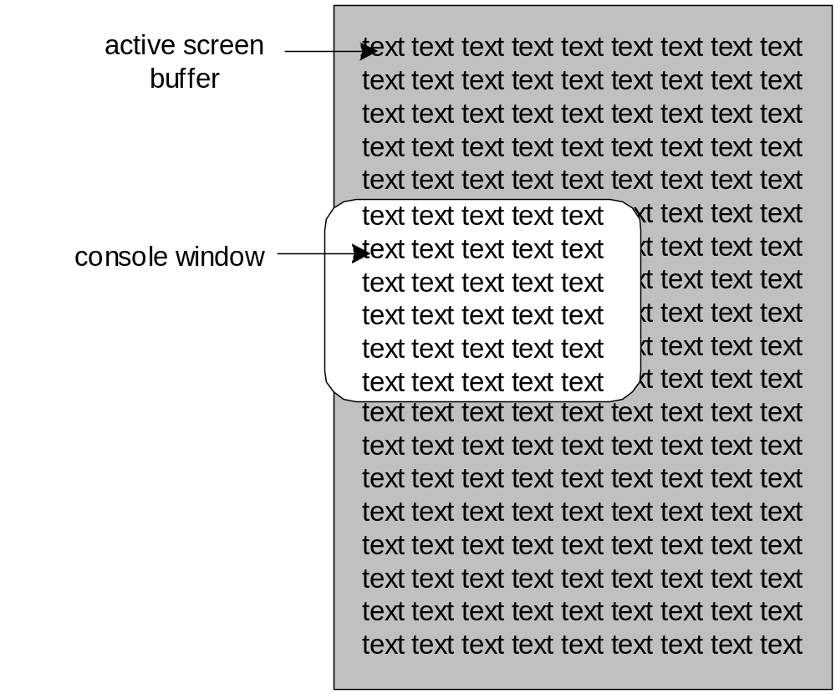
Screen Buffer and Console Window
The active screen buffer includes data displayed by the console window.

Slide 28
SetConsoleTitle
SetConsoleTitle changes the console window's title. Pass it a null-terminated string:
.data
titleStr BYTE "Console title",0
.code
INVOKE SetConsoleTitle, ADDR titleStr

Slide 29
GetConsoleScreenBufferInfo
GetConsoleScreenBufferInfo returns information about the current state of the console window. It has two parameters: a handle to the console screen, and a pointer to a structure that is filled in by the function:
.data
outHandle DWORD ?
consoleInfo CONSOLE_SCREEN_BUFFER_INFO <>
.code
INVOKE GetConsoleScreenBufferInfo,
outHandle,
ADDR consoleInfo

Slide 30
CONSOLE_SCREEN_BUFFER_INFO
CONSOLE_SCREEN_BUFFER_INFO STRUCT
dwSize COORD <>
dwCursorPos COORD <>
wAttributes WORD ?
srWindow SMALL_RECT <>
maxWinSize COORD <>
CONSOLE_SCREEN_BUFFER_INFO ENDS
dwSize - size of the screen buffer (char columns and rows)
dwCursorPos - cursor location
wAttributes - colors of characters in console buffer
srWindow - coords of console window relative to screen buffer
maxWinSize - maximum size of the console window

Slide 31
SetConsoleWindowInfo
SetConsoleWindowInfo lets you set the size and position of the console window relative to its screen buffer.
Prototype:
SetConsoleWindowInfo PROTO,
nStdHandle:DWORD, ; screen buffer handle
bAbsolute:DWORD, ; coordinate type
pConsoleRect:PTR SMALL_RECT ; window rectangle

Slide 32
SetConsoleScreenBufferSize
SetConsoleScreenBufferSize lets you set the screen buffer size to X columns by Y rows.
Prototype:
SetConsoleScreenBufferSize PROTO,
outHandle:DWORD, ; handle to screen buffer
dwSize:COORD ; new screen buffer size

Slide 33
Controlling the Cursor
GetConsoleCursorInfo
  returns the size and visibility of the console cursor
SetConsoleCursorInfo
  sets the size and visibility of the cursor
SetConsoleCursorPosition
  sets the X, Y position of the cursor

Slide 34
CONSOLE_CURSOR_INFO
Structure containing information about the console’s cursor size and visibility:
CONSOLE_CURSOR_INFO STRUCT
dwSize DWORD ?
bVisible BYTE ?
CONSOLE_CURSOR_INFO ENDS

Slide 35
SetConsoleTextAttribute
Sets the foreground and background colors of all subsequent text written to the console.
Prototype:
SetConsoleTextAttribute PROTO,
outHandle:DWORD, ; console output handle
nColor:DWORD ; color attribute

Slide 36
WriteConsoleOutputAttribute
Copies an array of attribute values to consecutive cells of the console screen buffer, beginning at a specified location.
Prototype:
WriteConsoleOutputAttribute PROTO,
outHandle:DWORD, ; output handle
pAttribute:PTR WORD, ; write attributes
nLength:DWORD, ; number of cells
xyCoord:COORD, ; first cell coordinates
lpCount:PTR DWORD ; number of cells written

Slide 37
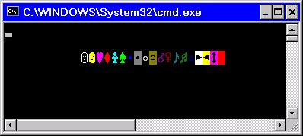
WriteColors Program
Creates an array of characters and an array of attributes, one for each character
Copies the attributes to the screen buffer
Copies the characters to the same screen buffer cells as the attributes
Sample output:
(starts in row 2, column 10)
View the source code

Slide 38
Time and Date Functions
GetLocalTime, SetLocalTime
GetTickCount, Sleep
GetDateTime
SYSTEMTIME Structure
Creating a Stopwatch Timer

Slide 39
GetLocalTime, SetLocalTime
GetLocalTime returns the date and current time of day, according to the system clock.
SetLocalTime sets the system’s local date and time.
GetLocalTime PROTO,
pSystemTime:PTR SYSTEMTIME
SetLocalTime PROTO,
pSystemTime:PTR SYSTEMTIME

Slide 40
GetTickCount, Sleep
GetTickCount function returns the number of milliseconds that have elapsed since the system was started.
Sleep pauses the current program for a specified number of milliseconds.
GetTickCount PROTO ; return value in EAX
Sleep PROTO,
dwMilliseconds:DWORD

Slide 41
GetDateTime
The GetDateTime procedure in the Irvine32 library calculates the number of 100-nanosecond time intervals that have elapsed since January 1, 1601. Pass it a pointer to an empty 64-bit FILETIME structure, which is then filled in by the procedure:
GetDateTime PROC,
pStartTime:PTR QWORD
FILETIME STRUCT
loDateTime DWORD ?
hiDateTime DWORD ?
FILETIME ENDS

Slide 42
SYSTEMTIME Structure
SYSTEMTIME is used by date and time-related Windows API functions:
SYSTEMTIME STRUCT
wYear WORD ? ; year (4 digits)
wMonth WORD ? ; month (1-12)
wDayOfWeek WORD ? ; day of week (0-6)
wDay WORD ? ; day (1-31)
wHour WORD ? ; hours (0-23)
wMinute WORD ? ; minutes (0-59)
wSecond WORD ? ; seconds (0-59)
wMilliseconds WORD ? ; milliseconds (0-999)
SYSTEMTIME ENDS

Slide 43
Creating a Stopwatch Timer
The Timer.asm program demonstrates a simple stopwatch timer
It has two important functions:
  TimerStart - receives a pointer to a doubleword, into which it saves the current time
  TimerStop - receives a pointer to the same doubleword, and returns the difference (in milliseconds) between the current time and the previously recorded time
Calls the Win32 GetTickCount function
View the source code

Slide 44
Writing a Graphical Windows Application
Required Files
POINT, RECT Structures
MSGStruct, WNDCLASS Structures
MessageBox Function
WinMain, WinProc Procedures
ErrorHandler Procedure
Message Loop & Processing Messages
Program Listing

Slide 45
Required Files
make32.bat - Batch file specifically for building this program
WinApp.asm - Program source code
GraphWin.inc - Include file containing structures, constants, and function prototypes used by the program
kernel32.lib - Same MS-Windows API library used earlier in this chapter
user32.lib - Additional MS-Windows API functions

Slide 46
POINT and RECT Structures
POINT - X, Y screen coordinates
RECT - Holds the graphical coordinates of two opposing corners of a rectangle
POINT STRUCT
ptX DWORD ?
ptY DWORD ?
POINT ENDS
RECT STRUCT
left DWORD ?
top DWORD ?
right DWORD ?
bottom DWORD ?
RECT ENDS

Slide 47
MSGStruct Structure
MSGStruct - holds data for MS-Windows messages (usually passed by the system and received by your application):
MSGStruct STRUCT
msgWnd DWORD ?
msgMessage DWORD ?
msgWparam DWORD ?
msgLparam DWORD ?
msgTime DWORD ?
msgPt POINT <>
MSGStruct ENDS

Slide 48
WNDCLASS Structure (1 of 2)
Each window in a program belongs to a class, and each program defines a window class for its main window:
WNDCLASS STRUC
style DWORD ? ; window style options
lpfnWndProc DWORD ? ; WinProc function pointer
cbClsExtra DWORD ? ; shared memory
cbWndExtra DWORD ? ; number of extra bytes
hInstance DWORD ? ; handle to current program
hIcon DWORD ? ; handle to icon
hCursor DWORD ? ; handle to cursor
hbrBackground DWORD ? ; handle to background brush
lpszMenuName DWORD ? ; pointer to menu name
lpszClassName DWORD ? ; pointer to WinClass name
WNDCLASS ENDS

Slide 49
WNDCLASS Structure (2 of 2)
style is a conglomerate of different style options, such as WS_CAPTION and WS_BORDER, that control the window’s appearance and behavior.
lpfnWndProc is a pointer to a function (in our program) that receives and processes event messages triggered by the user.
cbClsExtra refers to shared memory used by all windows belonging to the class. Can be null.
cbWndExtra specifies the number of extra bytes to allocate following the window instance.
hInstance holds a handle to the current program instance.
hIcon and hCursor hold handles to icon and cursor resources for the current program.
hbrBackground holds a background (color) brush.
lpszMenuName points to a menu string.
lpszClassName points to a null-terminated string containing the window’s class name.

Slide 50
MessageBox Function
Displays text in a box that pops up and waits for the user to click on a button:
MessageBox PROTO,
hWnd:DWORD,
pText:PTR BYTE,
pCaption:PTR BYTE,
style:DWORD
hWnd is a handle to the current window. pText points to a null-terminated string that will appear inside the box. pCaption points to a null-terminated string that will appear in the box’s caption bar. style is an integer that describes both the dialog box’s icon (optional) and the buttons (required).

Slide 51
MessageBox Example
Displays a message box that shows a question, including an OK button and a question-mark icon:
.data
hMainWnd DWORD ?
QuestionText BYTE "Register this program now?"
QuestionTitle BYTE "Trial Period Has Expired"
.code
INVOKE MessageBox,
hMainWnd,
ADDR QuestionText,
ADDR QuestionTitle,
MB_OK + MB_ICONQUESTION

Slide 52
WinMain Procedure
Every Windows application needs a startup procedure, usually named WinMain, which is responsible for the following tasks:
Get a handle to the current program
Load the program’s icon and mouse cursor
Register the program’s main window class and identify the procedure that will process event messages for the window
Create the main window
Show and update the main window
Begin a loop that receives and dispatches messages

Slide 53
WinProc Procedure
WinProc receives and processes all event messages relating to a window
  Some events are initiated by clicking and dragging the mouse, pressing keyboard keys, and so on
WinProc decodes each message, carries out application-oriented tasks related to the message
WinProc PROC,
hWnd:DWORD, ; handle to the window
localMsg:DWORD, ; message ID
wParam:DWORD, ; parameter 1 (varies)
lParam:DWORD ; parameter 2 (varies)
(Contents of wParam and lParam vary, depending on the message.)

Slide 54
Sample WinProc Messages
In the example program from this chapter, the WinProc procedure handles three specific messages:
  WM_LBUTTONDOWN, generated when the user presses the left mouse button
  WM_CREATE, indicates that the main window was just created
  WM_CLOSE, indicates that the application’s main window is about to close
(many other messages are possible)

Slide 55
ErrorHandler Procedure
The ErrorHandler procedure has several important tasks to perform:
  Call GetLastError to retrieve the system error number
  Call FormatMessage to retrieve the appropriate system-formatted error message string
  Call MessageBox to display a popup message box containing the error message string
  Call LocalFree to free the memory used by the error message string
(sample)

Slide 56
ErrorHandler Sample
INVOKE GetLastError ; Returns message ID in EAX
mov messageID,eax
; Get the corresponding message string.
INVOKE FormatMessage, FORMAT_MESSAGE_ALLOCATE_BUFFER + \
FORMAT_MESSAGE_FROM_SYSTEM, NULL, messageID, NULL,
ADDR pErrorMsg, NULL, NULL
; Display the error message.
INVOKE MessageBox, NULL, pErrorMsg, ADDR ErrorTitle,
MB_ICONERROR + MB_OK
; Free the error message string.
INVOKE LocalFree, pErrorMsg

Slide 57
Message Loop
In WinMain, the message loop receives and dispatches (relays) messages:
Message_Loop:
; Get next message from the queue.
INVOKE GetMessage, ADDR msg, NULL,NULL,NULL
; Quit if no more messages.
.IF eax == 0
jmp Exit_Program
.ENDIF
; Relay the message to the program's WinProc.
INVOKE DispatchMessage, ADDR msg
jmp Message_Loop

Slide 58
Processing Messages
WinProc receives each message and decides what to do with it:
WinProc PROC, hWnd:DWORD, localMsg:DWORD,
wParam:DWORD, lParam:DWORD
mov eax, localMsg
.IF eax == WM_LBUTTONDOWN ; mouse button?
INVOKE MessageBox, hWnd, ADDR PopupText,
ADDR PopupTitle, MB_OK
jmp WinProcExit
.ELSEIF eax == WM_CREATE ; create window?
INVOKE MessageBox, hWnd, ADDR AppLoadMsgText,
ADDR AppLoadMsgTitle, MB_OK
jmp WinProcExit
(etc.)

Slide 59
Program Listing
View the program listing (WinApp.asm)
Run the program
When linking the program, remember to replace
/SUBSYSTEM:CONSOLE
with: /SUBSYSTEM:WINDOWS

Slide 60
IA-32 Memory Management
Reviewing Some Terms
New Terms
Translating Addresses
Converting Logical to Linear Address
Page Translation

Slide 61
Reviewing Some Terms
Multitasking permits multiple programs (or tasks) to run at the same time. The processor divides up its time between all of the running programs.
Segments are variable-sized areas of memory used by a program containing either code or data.
Segmentation provides a way to isolate memory segments from each other. This permits multiple programs to run simultaneously without interfering with each other.
A segment descriptor is a 64-bit value that identifies and describes a single memory segment: it contains information about the segment’s base address, access rights, size limit, type, and usage.

Slide 62
New Terms
A segment selector is a 16-bit value stored in a segment register (CS, DS, SS, ES, FS, or GS).
  provides an indirect reference to a memory segment
A logical address is a combination of a segment selector and a 32-bit offset.

Slide 63
Translating Addresses
The IA-32 processor uses a one- or two-step process to convert a variable's logical address into a unique memory location.
The first step combines a segment value with a variable’s offset to create a linear address.
The second optional step, called page translation, converts a linear address to a physical address.

Slide 64
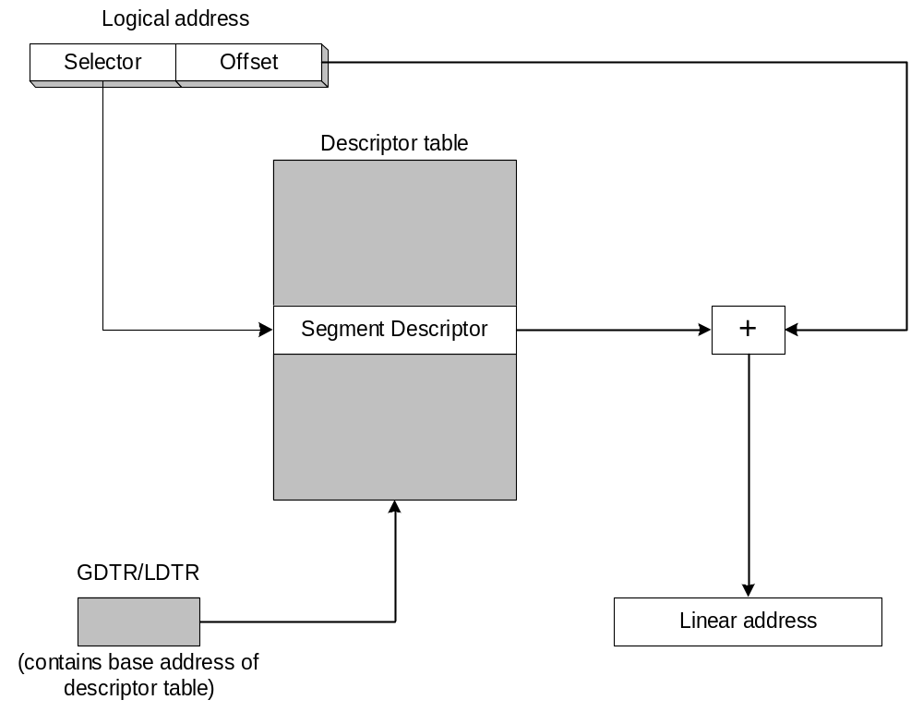
Converting Logical to Linear Address
The segment selector points to a segment descriptor, which contains the base address of a memory segment. The 32-bit offset from the logical address is added to the segment’s base address, generating a 32-bit linear address.

Slide 65
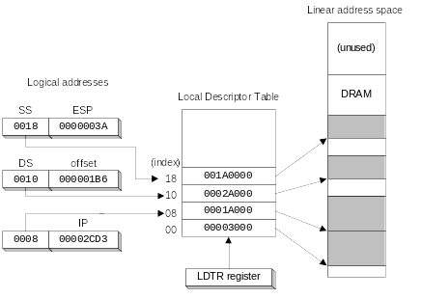
Indexing into a Descriptor Table
Each segment descriptor indexes into the program's local descriptor table (LDT). Each table entry is mapped to a linear address:

Slide 66
Paging (1 of 2)
Paging makes it possible for a computer to run a combination of programs that would not otherwise fit into memory.
Only part of a program must be kept in memory, while the remaining parts are kept on disk.
The memory used by the program is divided into small units called pages.
As the program runs, the processor selectively unloads inactive pages from memory and loads other pages that are immediately required.

Slide 67
Paging (2 of 2)
OS maintains page directory and page tables
Page translation: CPU converts the linear address into a physical address
Page fault: occurs when a needed page is not in memory, and the CPU interrupts the program
OS copies the page into memory, program resumes execution

Slide 68
Page Translation
A linear address is divided into a page directory field, page table field, and page frame offset. The CPU uses all three to calculate the physical address.

Slide 69

The End

